Slide 1

E-SHOP PROJECT

Slide 2
MAIVEN
A tool that can be used for building and managing any Java-based project.
Maven allows a project to build using its project object model (POM) and a set of plugins that are shared by all
projects using Maven, providing a uniform build system. Based on the dependencies you need to mention the exact
name in this pom.xml file. For example, if you need Hibernate dependencies, you need to specify it within the
dependencies tags.
Advantages of Maven:
Eases the building process for any project.
It maintains a uniformity along the entire build process.
It’s very important to understand the project that we are working on.
It provides Comprehensive information about the project.
To ensure quality in a project, it’s necessary to develop it in the best possible
manner and It provides the guidelines to do just that.
Often in a project, it’s required to migrate to new features and with Maven, the migration is simplified.

Slide 3
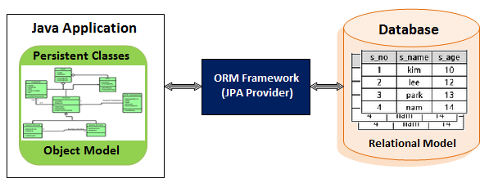
Object Relational Mapping
Data persistence
Applications need to save data to persistence storage.
Database is persistence storage
Application needs to interact with database:
web app --create, update, delete-> Database
web app <------retrieve--------------- Database
Database store data in tables, which are not like object.
Data Mapper :
each object is saved as a row in database table
each row is retrieved as an object in application
ORM Provider
JPA(Java Persistence API) is a Java application programming interface specification that describes the management of relation data in applications.
Hibernate provides an open source ORM framework for Java
Spring framework supports integration with Hibernate and JPA for resource management, data access object (DAO) implementation, and transaction management.

Slide 4
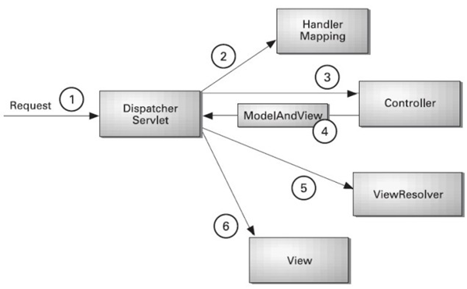
Model View Controller
Model directly manages the data, logic and rules of the application.
View can be any output representation of information.
Controller, accepts input and converts it to commands for the model or view.
Spring Web MVC framework provides MVC architecture and ready components that can be used to develop flexible and loosely coupled web applications.
Model encapsulates the application data and in general they will consist of POJO (plain old java object).
View is responsible for rendering the model data and in general it generate HTML output that the client's browser can interpret.
Controller is responsible for processing user requests and building appropriate model and passes it to the view for rendering.

Slide 5
E-SHOP FLOW DIAGRAM
View
Products
Register
as Customer
User
Login
Customer
Add Product
to Cart
Check-out
Admin
Review
Order info
Submit
Order

Slide 6
E-SHOP ENTITY RELATIONSHIP DIAGRAM
users
PK | id
 | name
 | password
groups
FK | user_id
FK | group_id
groups
PK | id
 | name
order_details
PK | id
 | name
 | surname
 | address
 | email
 | phone
product
PK | id
 | name
 | photo
 | price
item
PK | id
FK | product_id
 | quantity
FK | order_id

